Slide 1

“Living Together in the Spirit”
6:1 – 10
Week 13
13 April 2022

Slide 2

Galatians Overview
In this final chapter, Paul reveals that liberty in Christ involves responsibilities. Those who are “spiritual” are to restore those overtaken in trespasses, and all are to bear one another's burden thereby fulfilling the “law of Christ” (1-2).
At the same time, each Christian ought to examine himself and seek to bear his own load (3-5).
Further responsibilities involve sharing with those who teach, and not growing weary in doing good to all, especially those of the household of faith. As motivation to do good, Paul reminds them of the principles of “sowing” and “reaping,” particularly as it relates to the flesh and Spirit (6-10).

Slide 3
Galatians Introduction
One of the greatest commands in the NT is “be filled with the Spirit” (Eph 5:18). This simple yet important command represents a transfer of the control of our lives from ourselves to the living Lord. But being filled with the Spirit does not end in a private realm or some mystical experience.
It’s not speaking in strange tongues or performing miraculous sign and wonders. It’s not even about having some kind of emotional response or a profound encounter with the Master. Biblically speaking, being filled with the Spirit primarily affects our relationships with others.

Slide 4
Galatians Introduction
Speaking the truth in love, gently restoring wayward brothers and sisters in Christ, comforting those who grieve, giving assistance and encouragement to those in need—these are the marks of a person who is filled with the Spirit.
Contrary to what our individualistic society promotes, the spiritual life is far more than independent devotion or personal experience. Don’t misread me. It’s not any less than our personal relationship with Christ. But that is only the starting point. If that’s our end point, we’ve completely missed the point. Our vertical relationship with the Father, which comes through the Son and is energized by the Holy Spirit, is meant to affect our horizontal relationship with those around us—with our nearest loved ones, our church famil, our neighbors, and even total strangers.

Slide 5
Galatians Introduction
We’ll see that life in the Spirit is a life seasoned with grace—another demonstration that grace is not only the way to life, but the way of life.
5:26 > “Let us not become conceited, provoking and envying each other.”
Part of relating to others in the Spirit involves knowing what not to do. Galatians 5:26 transitions us from Paul’s sharp contrast between the deeds of the flesh and the fruit of the Spirit in 5:19-23, moving to the effects of both lifestyles on our interactions with others. Paul exhorts his readers to avoid boasting, challenging, and envying (5:26).

Slide 6
Galatians Introduction
This underscores the reality that fleshly living is always self-centered, self-focused, and self-satisfying. In contrast, living by the Spirit places the emphasis on others.
To become “conceited” means to boast where there is nothing to boast about. Such a warning would fit well with the Galatians’ background of legalism. Legalism always puffs us up and tears down others as it flaunts a person’s own accomplishments by his or her own power. The boastful (conceited) forget that they have been shown grace.

Slide 7
Galatians Introduction
Paul also warns the Galatian to avoid “provoking” or challenging one another. The verb means to “call forth” a person in a challenge or to provoke a person to anger. It paints the picture of someone with a competitive spirit, a person who can’t let things go.
This individual is quick to jump into any disagreement, always ready to pick a fight, and eager to challenge every authority. This is a person who has to be right and must have the last word. Provokers fail to show grace toward others.

Slide 8
Galatians Introduction
Finally, Paul warns about being “jealous” or envying one another. It is a sin rooted in feelings of inferiority and insecurity. In such a case, possessions, abilities, and accomplishments take center stage.
“Keeping up with the Joneses” becomes a way of life, resulting in failure to rest contentedly in our secure and exalted position in Jesus Christ. Those who are envious fail to demonstrate grace deep within themselves by being content with who they are and what they have. It’s a miserable way to live!

Slide 9

“Living Together in the Spirit”

Slide 10
Galatians 6:1 – 6
¹Brothers and sisters, if someone is caught in a sin, you who live by the Spirit should restore that person gently. But watch yourselves, or you also may be tempted. ²Carry each other’s burdens, and in this way you will fulfill the law of Christ. ³If anyone thinks they are something when they are not, they deceive themselves. ⁴Each one should test their own actions. Then they can take pride in themselves alone, without comparing themselves to someone else, ⁵for each one should carry their own load. ⁶Nevertheless, the one who receives instruction in the word should share all good things with their instructor.

Slide 11
Galatians 6:1 – 6
Having provided a snapshot of what it looks like to walk in the flesh, Paul now begins to illustrate how to relate to one another in the Spirit. He sets forth four distinct imperatives for believers that relate to bearing with one another:
Restore those who stumble, without falling into temptation (6:1).
Bear one another’s burdens according to Christ’s law (6:2-3).
Take personal responsibility with humility (6:4-5).
Support your teachers with generosity (6:6).

Slide 12
Galatians 6:1 – 6
Let’s look more closely at each of these imperatives:
FIRST – Restore those who stumble, without falling into temptation (6:1).
Paul begins by describing a grace-oriented, Spirit-filled response to fellow believers who wander from the path of submission to God and obedience to His Word. Legalists, of course, would condemn them. Or they would slap collars around their necks and keep them on short leashes. Or they would say “I told you so” to demonstrate their own spiritual superiority. But this is not the way of the Spirit-filled believer.
In the body of Christ, believers care about and are therefore responsible for each other.

Slide 13
Galatians 6:1 – 6
When we see a brother or sister sliding downward into sin, we can’t simply turn away, hang our heads, and pretend it’s only the minister’s responsibility to confront the wayward.
Paul explains how true spiritual restoration works. FIRST – restoration is necessary when a person is “caught” in sin. That is, the person has gotten snared by the lures of the world. The person is not just a mere perpetrator of sin, but a victim of temptation.
We must realize that any one of us could find ourselves flat on our own face, having stumbled headlong into a trap and needing somebody to help us out. We need to understand this before we begin the restoration process.

Slide 14
Galatians 6:1 – 6
SECOND – Paul limits the intervention to those who are “spiritual.” These aren’t spiritual giants who have somehow eradicated their sin natures and are living miraculously pure lives. If we had to wait for a perfect saint to implement spiritual restoration, we would be waiting forever.
Rather, in this context, the “spiritual” are those who, in a particular situation, have been given the spiritual mindset and relational vantage point to see the situation with moral clarity because they are not clouded by the fog that dulls the consciences of unrepentant sinners.

Slide 15
Galatians 6:1 – 6
The word “restore” calls for spiritual therapy so that a broken member of the body can once again work properly and perform its vital functions for the benefit of the whole body. Paul links restoration with one aspect of the fruit of the Spirit: gentleness. No wonder Paul says that only those who are spiritual can accomplish the difficult task of restoration.
FINALLY – the restorers must look to themselves to avoid falling into temptation. We must walk into every confrontation with our eyes wide open, with a keen sense of our own weaknesses and vulnerabilities. We may not necessarily be tempted to sin in the same way as the person we’re hoping to restore, but we may be tempted with pride, harshness, gossip, or legalism.

Slide 16
Galatians 6:1 – 6
SECOND – Bear one another’s burdens according to Christ’s law (6:2-3).
No one is meant to “go it along,” and no one is without his or her own burdens. Paul warns against the pride of deceptive self-sufficiency in 6:3 > “If anyone thinks he is something when he is nothing, he deceives himself.” The truth is that life heaps all kinds of baggage onto everyone’s shoulders.
In the Christian life, there’s no room for “just leave me alone” or “I’m fine by myself.” We all need someone to counsel us, embrace us, and comfort us. Yes, the Spirit is the One who comforts and counsels us, but He most often does this by empowering Spirit-filled people to bear our burdens with us.

Slide 17
Galatians 6:1 – 6
When we bear each other’s burdens, we fulfill the law of Christ. That’s not a reference to the OT law or the Ten Commandments. The “law of Christ” refers to the principle of Christ-likeness summed up in the Savior’s command to love one another (5:14). This new commandment of Jesus is offered in John 13:34-35.
Paul’s words strike at the very heart of the Judaizers’ legalistic theology. Christianity does not center on the Law of Moses and its principle of strict justice but on the law of Christ and its principle of mercy and grace. The Spirit-bestowed fruit of love provides the supernatural ability to bear each other’s burdens with humility and gentleness.

Slide 18
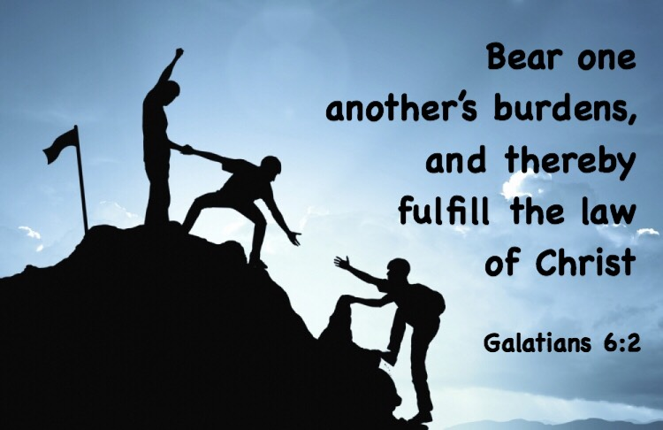

Slide 19
Galatians 6:1 – 6
THIRD – Take personal responsibility with humility (6:4-5).
At first glance, Paul’s statement about “boasting in regard to himself alone” sounds like a contradiction to his command in 5:26 > “Let us not become conceited.” And his conclusion in 6:5 > “For each one will bear his own load” seems to fly in the face of his command in 6:2 > “Bear one another’s burdens.” How do we explain this?
Paul is stressing personal responsibility. It is not for one Christian to assess or judge the ministry of another; each one is answerable to God for his own. The real issue here is comparison, and Paul once again addresses the problem that originally surfaced in 5:26 > “challenging one another.”

Slide 20
Galatians 6:1 – 6
In other words, Paul is saying > “Instead of boasting about how much better you are than others—or envying other for how much better they are than you—recognize that you are personally accountable before God and don’t worry about everybody else around you.”
Whose burdens are we supposed to bear? Our own? Somebody else’s? If we’re supposed to bear our own burdens, then why would anybody be told to bear mine?
SWINDOLL points out the difference between two Greek words Paul uses: “burden” in 6:2 and “load” in 6:5.

Slide 21
Galatians 6:1 – 6
Though these two words are basically synonymous in other contexts, the change in nouns in this context indicates a change of reference.
In v2, “burden” refers to the need to come to the aid of others who cannot carry the crushing burden of the consequences of their sin.
In v5, “load” refers to work given to us by our Master, before whom we will have to give an account of how we used the opportunities and talents he gave us to serve him.

Slide 22
Galatians 6:1 – 6
FOURTH – Support your teachers with generosity (6:6).
SWINDOLL: Most teachers and preacher are uneasy talking about, preaching about, and especially asking for money. But finances come up quite frequently in the Bible, so the topic can’t be avoided. Most average people, however, don’t quite get what paying the pastor has to do with the Spirit-filled life. Paul addresses this question head-on.
In 6:6 he reminds his readers of their responsibility to support those who teach them the Word of God. This would have been an especially important admonition to the Galatians. In an environment where the Judaizers were trying to snuff out the light of the gospel, any teacher standing for the truth should be supported financially.

Slide 23
Galatians 6:1 – 6
To neglect this would be to squeeze off the gospel at its source—the appointed teacher or preacher. Studying and teaching the Word of God takes time and discipline.
Paul is saying that part of a believer’s spiritual responsibility is to share his or her abundance with those who work hard in the Word of God (1Tim 5:17:18 > “Let the elders that rule well be counted worthy of double honor, especially they who labor in the word and doctrine. ¹⁸For the scripture saith, thou shalt not muzzle the ox that treads out the corn. And, the laborer is worthy of his reward”).
As the pastor shares spiritual wealth with his flock, the flock should share material goods with him. In the grace-oriented, Spirit-filled church, pastor and congregation are to look out for one another.

Slide 24


Slide 25
Galatians 6:7 – 10
⁷Do not be deceived: God cannot be mocked. A man reaps what he sows. ⁸Whoever sows to please their flesh, from the flesh will reap destruction; whoever sows to please the Spirit, from the Spirit will reap eternal life. ⁹Let us not become weary in doing good, for at the proper time we will reap a harvest if we do not give up. ¹⁰Therefore, as we have opportunity, let us do good to all people, especially to those who belong to the family of believers.

Slide 26
Galatians 6:7 – 10
“Whatever a man sows, this he will also reap.” Paul offers us four easy-to-remember principles, which Swindoll calls “the law of the harvest”:
1] We sow and reap in like kind.
2] We reap in a different season than the one we sow in.
3] We reap more than we sow.
4] We must let go of past harvests and focus on sowing for the future today.

Slide 27
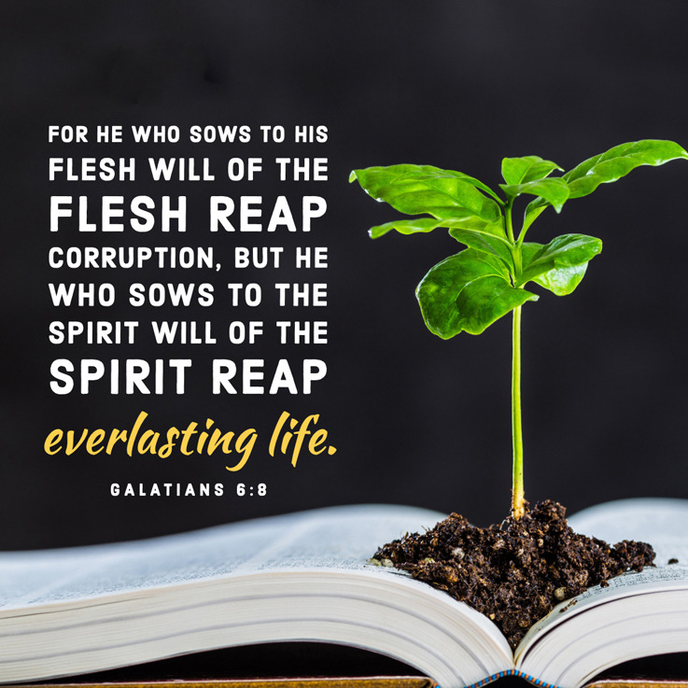

Slide 28
Galatians 6:7 – 10
1] We sow and reap in like kind.
If you plant watermelon seeds in the spring, don’t expect to harvest grapes in the fall. So, if you dislike watermelons, don’t plant them.
2] We reap in a different season that the one we sow in.
Gardeners don’t plant seeds, pull up a lawn chair, and wait with a basket in hand to harvest. The seeds bear fruit in a different season.
3] We reap more than we sow.
I think gardeners would be pretty frustrated if each plant produced only one fruit bearing one seed to grow one new plant. God has created plants for fruitfulness and multiplication.

Slide 29
Galatians 6:7 – 10
4] We must let go of past harvests and focus on sowing for the future today.
Not every harvest produces a cornucopia of fruits and vegetables. Some harvests are flat and disappointing; others yield bumper crops. We can’t base future returns on past harvests. If we want to reap in the future, we need to plant in the present.
The laws of the harvest apply just as well to the spiritual life as they do to the natural. If we sow sinful thoughts and actions, we will reap the consequences. Those who patiently and faithfully plant seeds of God’s Word in their lives will later reap blessings of wisdom, peace, and joy. In other words, those who sow to the flesh shouldn’t expect to receive the blessings of the Spirit.

Slide 30
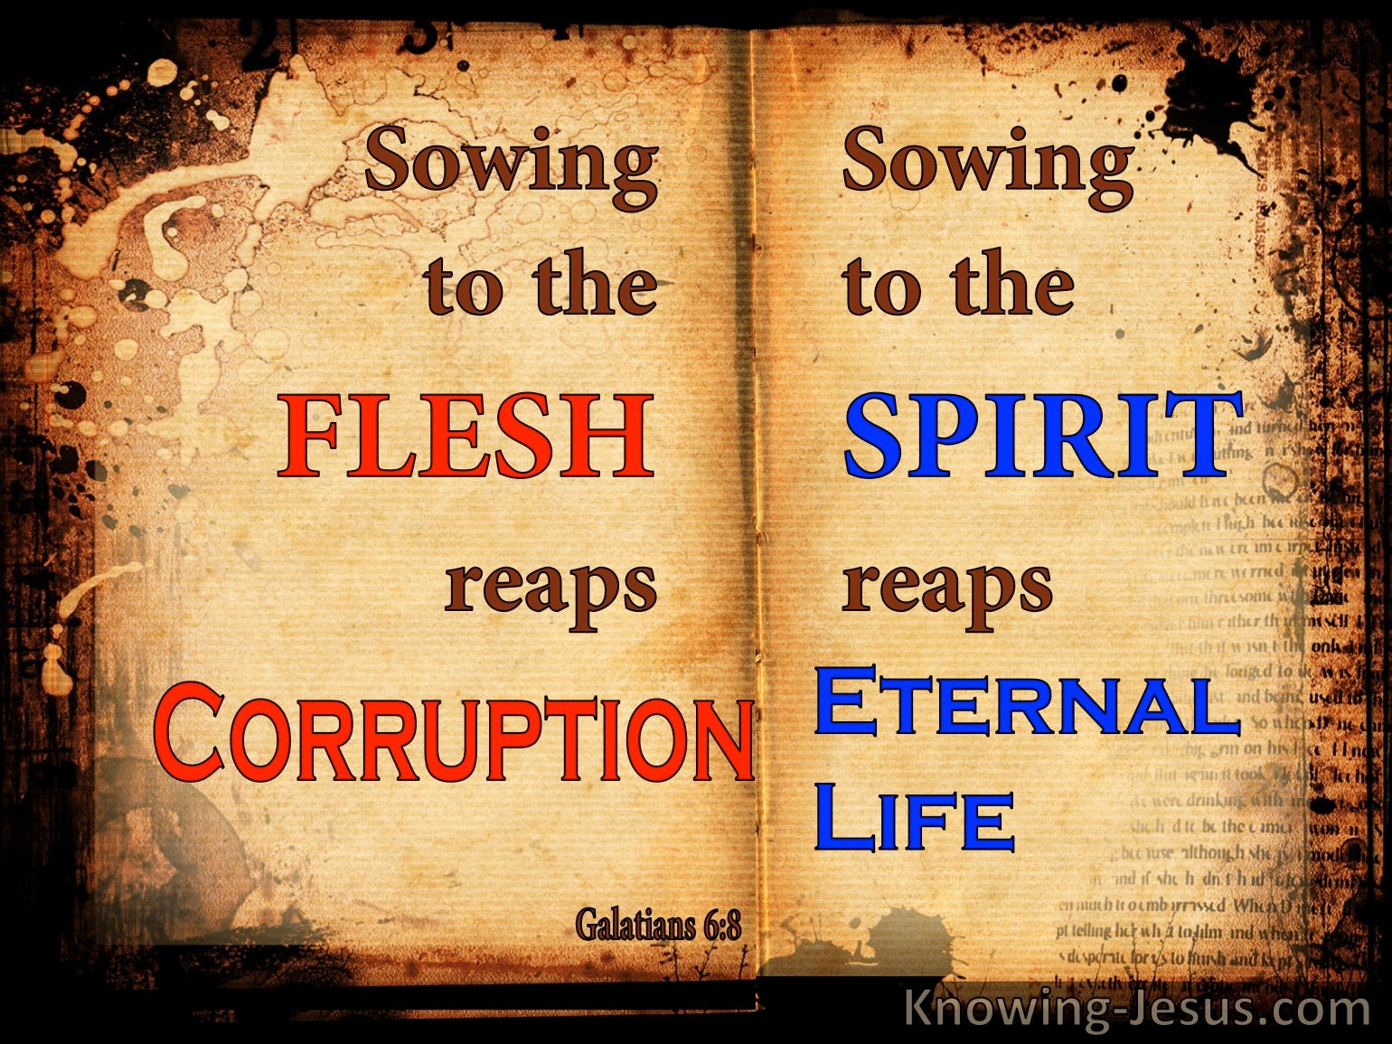

Slide 31
Galatians 6:7 – 10
Having set before his readers the ways of the flesh (5:19-21) and the ways of the Spirit (5:22-23), Paul emphasizes that both of these lifestyles will have their respective judgments or rewards.
Though we may fool ourselves into thinking we can somehow escape the laws of the harvest when it comes to sowing to the flesh, God will not be mocked. There will be consequences, even for believers saved by grace through faith and secure in their salvation.
The laws of the harvest work in both directions. If we sow to the flesh, we will reap corruption, but if we sow to the Spirit, allowing Him to manifest His fruit in our lives, we will reap a bountiful harvest (6:8).

Slide 32
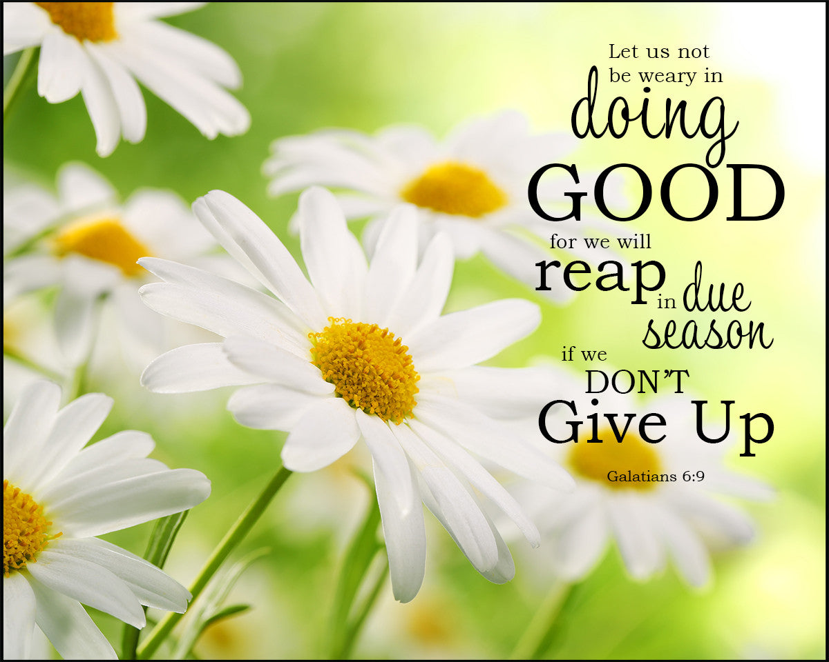

Slide 33
Galatians 6:7 – 10
To grow well, we have to sow well. But what does it mean to sow to the flesh? Quite simply, it means indulging in thoughts and actions that gratify the flesh. This includes the deeds of the flesh Paul listed in chapter 5.
On the other hand, sowing to the Spirit means engaging in thoughts and actions that please Christ. These include expressing our love for God through worship, prayer, and study of His Word. Sowing to the Spirit means living a life of love toward others by caring, meeting needs, encouraging, and confronting.
It means actively participating in concrete expressions of the fruit of the Spirit, knowing that God Himself is working in you to grow those seeds so that you may eventually reap and abundant harvest of blessings (9-10).

Slide 34
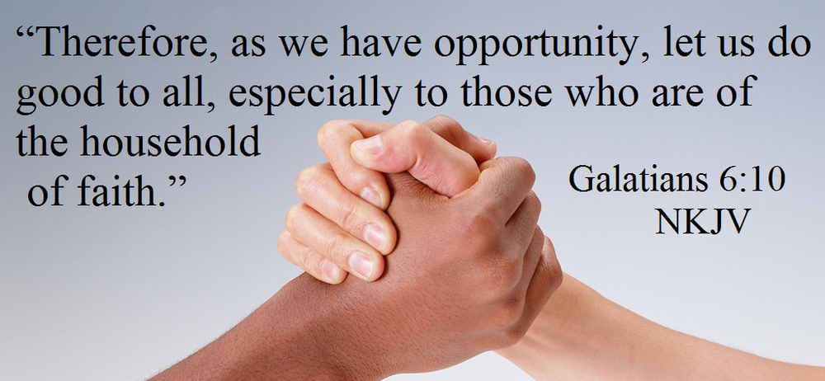

Slide 35



Slide 36
NEXT CLASS – 20 April 2022
Book of Galatians
Before next class, read the below verses in both the KJV and the NIV . . .
Chapter 6:11 – 6:18
“A Brief Reprise and a Blunt Reproof”
EBC Website for Handouts
https://bit.ly/surveyofpaulineepistles

